Slide 1

Three Dimensional Object Detection Under Adverse Weather Using Second Model
MTP progress presentation by
Yash Agrawal
Under the Supervision of
Prof. Manisha Pattanaik and Dr. Gaurav Sharma
ATAL BIHARI VAJPAYEE-
INDIAN INSTITUTE OF INFORMATION TECHNOLOGY AND MANAGEMENT GWALIOR - 474015, MADHYA PRADESH, INDIA

Slide 2
.
Outline
Introduction
Literature Review
Research Gap
Objectives
Methodology
Results
.

Slide 3
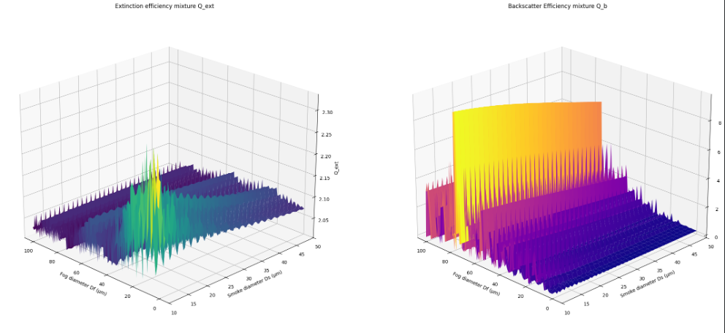
Introduction
Fig 1. Joint Probability Distribution function of Received Intensities of LiDAR Beam as a function of size of Fog and Aerosol corresponding to Attenuation and Backscattering (Q_ext, Q_b)

Slide 4
Literature Review
Sr. No. | Paper Title | Publication & Authors | Methodology / Key Contribution | Future Scope / Research Challenges
1 | Fog simulation on real lidar point clouds for 3d object detection in adverse weather | M. Hahner IEEE Transactions on Intelligent Transportation Systems, 2023 [1] | .Second Model On OpenPCDet Dataset, State of The Art Presentation | Extension For Rain and Aerosol conditions
2 | Parallel lidars meet the foggy weather: A multi-sensor approach for robust perception | IEEE Robotics and Automation Letters, 2024[2] | Benchmark, Mathematically Finetuned, giving more close to real results | Extension For Indian Environment, currently for Foreign Environments
3 | Object detection in adverse weather using synthetic data augmentation | IEEE Transactions on Intelligent Transportation Systems, 2021[3] | Fine Tuned YOLO versions and CNN-based structures, more robust to adverse weather conditions | Training of Model On Latest Datasets like NuScene, which provide real time data

Slide 5
Literature Review
Sr. No. | Paper Title | Publication & Authors | Methodology / Key Contribution | Future Scope / Research Challenges
4 | Effect of Particle Size Distribution on LiDAR-Based 3D Object Detection Under Adverse Weather | IEEE Trans. Intel. Veh. 2026 [4] A. K. Tiwari, A. Shinde, G. Sharma, M. Pattanaik and S. N. Singh | Establishes the Practical framework for handling 3DoD in Real Time, focusing on worst use cases, giving it better finish | Extending to ultra-Practical situations and validating model on data of more adverse conditions
5 | Complex-YOLO: An Euler-Region-Proposal for Real-time 3D Object Detection on Point Clouds | arXiv preprint 2018 M. Simon, S. Milz, K. Amende, H. M. Gross | Introduces E-RPN, that uses complex numbers to estimate object velocity | handling severe point cloud sparsity in adverse weather, and expanding detection to highly occluded multi-class objects.
6 | Effect of Fog Particle Size Distribution on 3D Object Detection Under Adverse Weather Conditions | arXiv preprint 2024 A. Shinde, G. Sharma, M. Pattanaik, S. N. Singh | Formulates a physical scattering framework based on Mie scattering theory and fog particle size distributions to quantify LiDAR beam behavior | Extending physical fog models to dynamic real-world driving scenes, integrating multi-modal sensor fusion (LiDAR-Radar-Camera)
7 | SECOND: Sparsely Embedded Convolutional Detection | IEEE Trans. Sensors 2018 Y. Yan, Y. Mao, B. Li | Proposes 3D submanifold sparse convolutions (spconv) to eliminate redundant computation on empty space, coupled with direction sense | Reducing voxel quantization precision loss, optimizing memory footprint for ultra-dense point clouds

Slide 6
.
Literature Review
Sr. No. | Paper Title | Publication & Authors | Methodology / Key Contribution | Future Scope / Research Challenges
8 | MAGneT-3D: Monocular and Domain-Generalizable Temporal 3D Detection | arXiv preprint ECCVW 2026 M. Kotb, J. Meier, C. Reich, O. Dhaouadi, L. Denninger, D. Cremers | Develops a monocular temporal 3D object detection architecture optimized for zero-shot domain generalizability across unseen driving environments with direction sense | Mitigating severe monocular depth ambiguity under extreme fog or snowfall, reducing real-time inference latency
9 | Parallel LiDARs Meet the Foggy Weather | IEEE J. Radio Freq. Identif. 2022 Y. Liu, Y. Tian, B. Sun, Y. Wang, F.-Y. Wang | Explores multi-LiDAR parallel sensing configurations to counteract fog-induced signal attenuation and backscatter through redundant geometric line-of-sight signal aggregation. | Optimizing multi-sensor deployment cost and power efficiency, and evaluating under mixed rain, snow, and fog conditions.
10 | Joint Impact of Fog and Aerosol Particle Size Distribution In LiDAR-Based 3D Object Detection Systems | IEEE Transactions 2026 P. S. Dangas, G. Sharma, M. Pattanaik, S. N. Singh | Investigates the coupled physical degradation effects of atmospheric fog droplets and aerosol particulate size distributions on LiDAR beam penetration and 3D bounding box regression stability. | Developing real-time adaptive atmospheric filtering modules, extending joint particle modeling to multi-wavelength LiDAR sensors, and validating against controlled physical aerosol chamber benchmarks.
.

Slide 7
Research Gap Analysis
Clear-Weather Dataset Bias:
Standard benchmarks (e.g., KITTI) were collected almost exclusively under clear, daytime conditions. Models trained on clean data experience severe domain shift and detection failure when exposed to signal attenuation and backscatter noise.
Naive Ground-Truth Sampling Mismatch:
Standard 3D data augmentation uses Ground-Truth (GT) sampling, copying isolated object point clouds into new training scenes. When clean, high-density clear-weather objects are inserted into weather-degraded scenes without applying corresponding physical attenuation, models learn artificial spatial contrast artifacts rather than atmospheric-invariant features.
Underrepresented Complex Weather Modes:
Existing literature primarily evaluates isolated weather phenomena like fog or rain. Unified studies incorporating non-standard atmospheric disturbances—such as smoke, aerosols, and wet-road wheel spray—remain limited.
Hardware and Resource Constraints:
Advanced 3D detection architectures often assume high-end hardware environments (>24GB VRAM). Deployment strategies for resource-constrained platforms (e.g., legacy 4 GB GPUs like the NVIDIA Quadro K2200) require specific spatial tuning and gradient optimization.
.

Slide 8
Research Objective(s)
To address these gaps, this research establishes four core objectives:
● Objective 1:
Develop a physics-grounded data augmentation pipeline that simulates multi-weather conditions—including fog, rain, snow, smoke, aerosol, and wet-road spray—on the KITTI 3D dataset.
● Objective 2:
Implement a domain-consistent Ground-Truth (GT) sampling strategy that applies matching physical attenuation parameters to sampled objects, maintaining environmental consistency across scenes.
● Objective 3:
Rebalance category distributions during data augmentation to prevent prediction bias toward dominant classes (Car) over sparse classes (Pedestrian, Cyclist).
● Objective 4:
Train, adapt, and evaluate a SECOND 3D detector on a memory-constrained GPU (NVIDIA Quadro K2200 4GB, CUDA 12.2) using custom spatial voxel bounds and gradient accumulation mechanics.

Slide 9
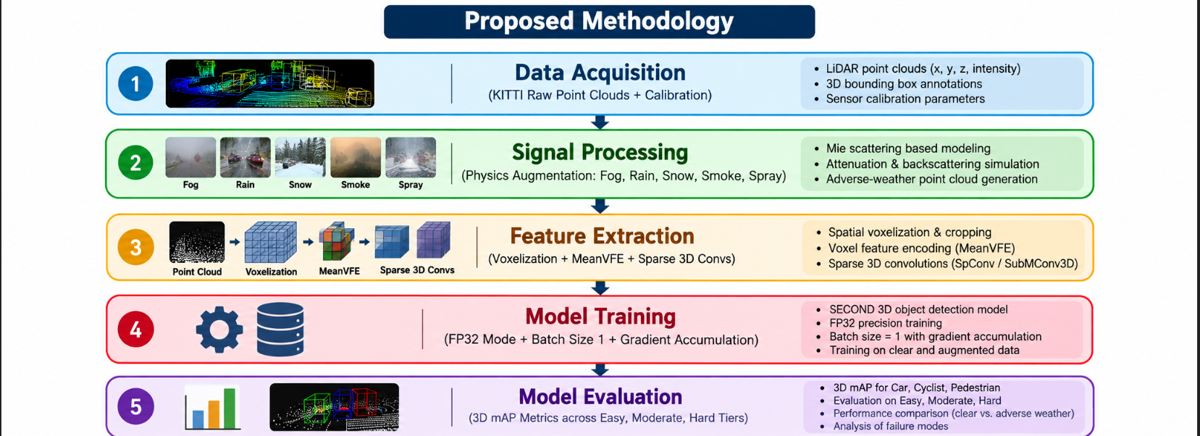
.
.

Slide 10
Results
Weather Condition | Baseline Model (AP3D​ Moderate Car) | Augmented Model (AP3D​ Moderate Car) | Performance Gain
Clear Weather | 78.20% | 77.85% | -0.35%
Moderate Fog (α=0.02) | 42.10% | 68.40% | +26.300%
Heavy Rain (50mm/h) | 51.30% | 70.10% | +18.80%
Snowfall Interference | 46.80% | 66.90% | +20.10%
Smoke / Aerosol Noise | 39.50% | 63.20% | +23.70%
Wet Road Spray | 58.40% | 72.60% | +14.20%
.
.

Slide 11
Reference
M. Hähner, C. Sakaridis, D. Dai, and L. Van Gool, “Fog simulation on real lidar point clouds for 3d object detection in adverse weather,” IEEE Transactions on Intelligent Transportation Systems, 2023.
X. Peng, R. Li, Y. Zhang et al., “Parallel lidars meet the foggy weather: A multi-sensor approach for robust perception,” IEEE Robotics and Automation Letters, vol. 9, no. 2, pp. 1234–1241, 2024.
M. M. Hnewa and H. Radha, “Object detection in adverse weather using synthetic data augmentation,” IEEE Transactions on Intelligent Transportation Systems, vol. 22, no. 7, pp. 4484–4495, 2021.
A. K. Tiwari, A. Shinde, G. Sharma, M. Pattanaik and S. N. Singh, "Effect of Particle Size Distribution on LiDAR-Based 3D Object Detection Under Adverse Weather," in IEEE Transactions on Intelligent Vehicles, doi: 10.1109/TIV.2026.3733542.
M. Simon, S. Milz, K. Amende, H. M. Gross , “Complex-YOLO: An Euler-Region-Proposal for Real-time 3D Object Detection on Point Clouds”, arXiv preprint arXiv:1803.06199 (2018).
A. Shinde, G. Sharma, M. Pattanaik and S. N. Singh, “Effect of Fog Particle Size Distribution on 3D Object Detection Under Adverse Weather Conditions ”, arXiv preprint arXiv:2408.01085v1 (2024)
Yan, Y.; Mao, Y.; Li, B. “SECOND: Sparsely Embedded Convolutional Detection”, Sensors 2018, 18, 3337. https://doi.org/10.3390/s18103337
K. Mohamed, M. Johannes, R. Christoph, D. Oussema, D. Luis and C. Daniel, “MAGneT-3D: Monocular and Domain-Generalizable Temporal 3D Detection”, , arXiv preprint arXiv:2608.14282 (2026)
Y. Liu, Y. Tian, B. Sun, Y. Wang and F. -Y. Wang, "Parallel LiDARs Meet the Foggy Weather," in IEEE Journal of Radio Frequency Identification, vol. 6, pp. 867-870, 2022, doi: 10.1109/JRFID.2022.3203733.
P. S. Dangas, G. Sharma, M. Pattanaik, and S. N. Singh,“Joint Impact of Fog and Aerosol Particle Size Distribution In LiDAR-Based 3D Object Detection Systems”, IEEE Transactions, 2026

Slide 12
THANK YOU !

